Slide 1
Integers
By
Mr Maddison

Slide 2
8
4
1. Oliver completes this calculation.
_
5
9
2
5
Write an addition calculation he could use to check his answer.
5
9
+
2
5
8
4
18,2,2

Slide 3
2. The numbers in this sequence increase by the same amount each time.
406,105 407,105 408,105 409,105 …….
What is the next number in this sequence?
410,105
18,2,6

Slide 4
3. Ellie buys 2 large boxes and 5 small boxes of chocolates.
Large Small
15
36 chocolates
chocolates
How many chocolates did Ellie buy altogether?
36
x 2
72
15
x 5
75
75
+ 72
147
147
chocolates
18,2,8

Slide 5

4. The list below shows the years in which the cricket world cup was held since 1992:
1992, 1996, 1999, 2003, 2007, 2011, 2015
Abel says:
Abel is not correct
Explain how you know.
The Cricket World Cup has been held every four years since 1992.
1999
-1996
3
So there were only three years between 1999 and 1996.
18,2,9

Slide 6
5.
>
=
<
Write the correct symbol in each box to make the statements correct.
117 =
9 x 13
80 ÷ 5
160 ÷ 4
200 x 8
<
12 x 10
8 x 2
240 ÷ 8
100 x 15
= 120
16 =
=
= 16
40 =
>
= 30
1600 =
>
= 1500
18,2,10

Slide 7
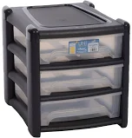
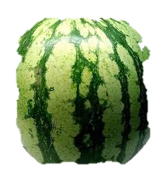
A box contains trays of melons.
There are 12 melons in tray.
There are 3 trays in a box.
A supermarket sells 60 boxes of melons.
How many melons does the supermarket sell?
12
x 3
36 in a box
36
x 60
2160 altogether
2160
melons
18,2,15

Slide 8

Sonny wants to use a mental method to calculate 156 - 98
He starts from 156
Here are some methods Sonny could use.
Tick the methods that are correct.
= 58
add 6 then subtract 90
subtract 100 then add 2
subtract 8 then subtract 90
subtract 2 then subtract 100
156 + 6 – 90 = 72
156 - 100 + 2 = 58
156 - 8 – 90 = 58
156 - 2 – 100 = 54
18,2,16

Slide 9
The numbers in this sequence increase by the same amount each time.
32
40 48 64
56
72
Write the missing numbers.
Increase of 8 each time
18,3,1

Slide 10
1
8
5
4
9. Here are four number cards.
Sophie uses each card once to make a four digit number.
She places:
5 in the tens column
1 so that it has a higher value than any of the other digits
the remaining two digits so that 4 has a higher value.
Write a digit in each box to show Sophie’s number.
1
4
5
8
18,3,3

Slide 11
10. Write the three missing digits to make this subtraction correct.
4
2
7
5
3
-
6
3
2
9
3
6
4
2
4
18,3,4

Slide 12
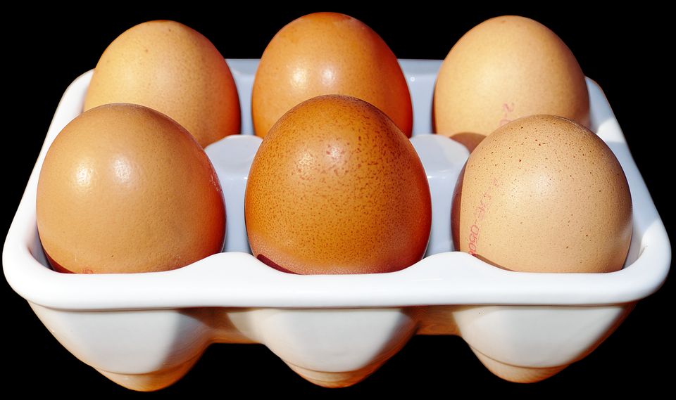
A farmer is packing eggs.
Each box holds six eggs.
141 R 4
6 850
The farmer has 850 eggs to pack.
How many boxes can the farmer fill using 850 eggs?
141
full boxes
How many eggs will be left over?
4
left over
18,3,7

Slide 13
12.
32,810 = 386 x 85
Use this multiplication to complete the calculations below.
386 x 8.5 =
3,281
3860 x 85 =
328,100
3,281 ÷ 8.5 =
386
18,3,19

Slide 14
13. Circle the number that is 10 times smaller than five hundred and nine.
509 ÷ 10
50.9 5,090 50,900 5.09 509
17,2c,2

Slide 15
14. Write the missing numbers to make this multiplication grid correct.
x
5 | 20 | 30
 | 36 | 54
4
6
9
17,2c,3

Slide 16
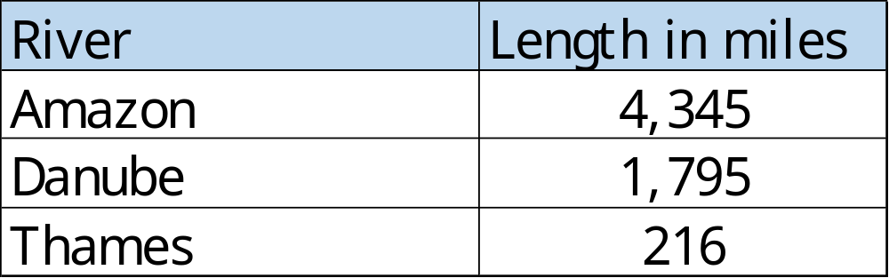
15. This table shows the lengths of three rivers.
Katie says the Amazon is more than double the Danube. Is she correct? You must show a calculation to explain your answer.
1795 x
2
3590
Yes because 4,345 is more than 3,590
17,2c,4

Slide 17
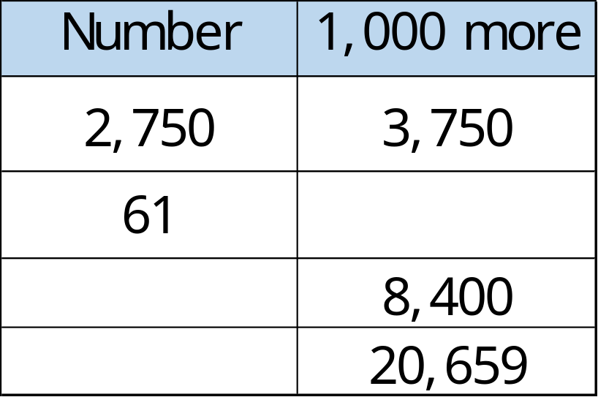
Complete this table with the missing numbers.
One row has been done for you.
1,061
7,400
19,659
17,2c,5

Slide 18
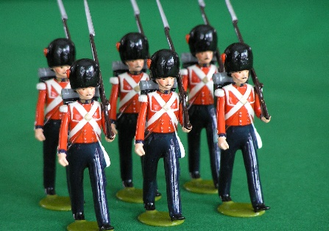
At the start of April, there were 495 toy soldiers in the shop.
During April,
2,895 more toy soldiers were delivered
1,821 toy soldiers were sold
How many toy soldiers were left in the shop at the end of April?
1,569
495 +
2895
3390
3390-
1821
1569
17,2c,8

Slide 19
A group of friends earns £75 by washing cars.
They share the money equally.
They get £15 each.
How many friends are in the group?
1 x 15 = 15
2 x 15 = 30
3 x 15 = 45
4 x 15 = 60
5 x 15 = 75
5
15
75
5
17,3c,2

Slide 20
Wyatt uses these digit cards.
He makes a 2-digit number and a 1-digit number.
He multiplies them together.
His answer is a multiple of 10.
What could Wyatt’s multiplication be?
6
5
3
3
6
5
x
17,3c,3

Slide 21
Scarlett buys 4 bags of white balloons.
Annabel buys 2 bags of red balloons.
Scarlett says,
‘I have four times as many balloons as Annabelle.’
Explain why Scarlett is correct.
30 white balloons in a pack
15 red balloons
in a pack
30 x
4
120
15 x
2
30
30 x
4
120
17,3c,12

Slide 22
There are 1,700 leaflets in a box.
Lacey and Liam take 290 leaflets each.
Aiden and Oliver share the rest of the leaflets equally.
How many leaflets does Oliver get?
560
290 x
2
580
1700 -
580
1120
2
1120
560
17,3c,16

Slide 23
Steve puts these five numbers in their correct places on a number line.
884 789 812 823 715
Write the number closest to 800
Write the number furthest from 800
789
715
16,2b,1

Slide 24
Put these houses in order of price starting with the lowest price.
A: £356,800 B: £180,200 C: £289,740 D: £202,999 E: £170,500
_________ ____________ ______________ _____________ ___________
lowest
E B D C A
16,2b,2

Slide 25
Write the three missing digits to make this addition correct.
4 8
+ 4 1
__________
1 8
7
3
9
16,2b,3

Slide 26
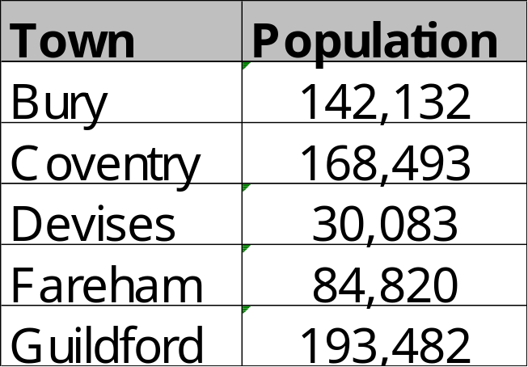
25. This table shows the number of people living in various towns in England.
168 493
+30 083
198 576
193 482
-142 132
51 350
What is the total of the numbers of people living in Coventry and in Devises?
What is the difference between the numbers of people living in Bury and in Guildford?
198 576
51 350
16,2b,4

Slide 27
Write the number that is three less than nine million.
Write the number that is one thousand less than five million.
8 999 997
9 000 000
3
8 999 997
5 000 000
- 1 000
4 999 000
4 999 000
16,2b,16

Slide 28
The numbers in this sequence increase by 17 each time.
79 96 130 147
62
113
164
16,3b,1

Slide 29
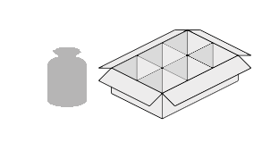
28. A toy shop orders 9 boxes of marbles.
Each box contains 6 bags of marbles.
Each bag contains 35 marbles.
How many marbles does the shop order in total?
35
marbles
A box contains 6 x 35
= 210
So 9 boxes contain 9 x 210
= 1890
1890
16,3b,11

Slide 30
Scarlett chooses a number less than 100.
She divides it by 5 and then adds 8
She then divides this result by 4
Her answer is 6
What was the number she started with?
6 x 4 = 24
24 – 8 = 16
16 x 5 = 80
80
16,3b,13

Slide 31
Circle two numbers that multiply together to equal 60 million.
200 2,000 30,000 300,000
16,3b,19

Slide 32
5,148 ÷ 13 = 396
Explain how you can use this fact to find the answer to 14 x 396
5,148 ÷ 13 = 396
is the same as
5,148 = 396 x 13
so 396 x 14 is another 396
5,148 + 396 =
5,544
16,3b,21

