Slide 1
Decimals and Money
By
Mr Maddison

Slide 2
Last year, Katie went to four concerts.
Three of her tickets cost £6 each.
The other ticket cost £8
Concert ticket
Concert ticket
£6
£8
Admit one person
Admit one person
What was the mean cost of the tickets?
6.50
Total cost =
3 x £6 + £8 =
£26
Mean = £26 ÷ 4
4 26.00
£6.50
18,3,18

Slide 3
2. Write these numbers in order of size, starting with the largest and decreasing.
0.091 0.9 0.089 0.88
0.089
0.091
0.88
0.9
smallest
17,2c,6

Slide 4
3. Oliver and Aiden buy some stickers.
Pack of 35 stickers
£34.50
35 stickers
99p each
Oiver buys a pack of 35 stickers for £34.50
Aiden buys 35 single stickers for 99p each.
How much more does Aiden pay than Oliver?
35 x 99p =
£35 – 35p =
£34.65
£34.65 –
£34.50
£ 0.15
0.15
£
17,2c,13

Slide 5
Sophie posts six large letters.
The postage costs the same for each letter.
She pays with a £10 note.
Her change is £2.74
What is the cost of posting one letter?
1.21
£10.00 –
£ 2.74
£ 7.26
6
7.26
1.21
£
17,2c,19

Slide 6
5. Write the missing number to make this division correct.
10
871 ÷ = 87.1
17,3c,1

Slide 7
The children at Castle School are collecting money for charity.
Their target is to collect £800
So far they have collected £632.21
How much more do they need to reach their target?
800.00 –
632.21
167.79
£
167.79
17,3c,5

Slide 8
9 bananas cost the same as 2 pineapples.
One pineapple costs £1.80
How much does one banana cost?
1.80 x
2
3.60
0.4
9
3.60
£
0.40
17,3c,14

Slide 9
8. Circle two numbers that add together to equal 0.94
0.34 0.14 0.9 0.6
16,2b,8

Slide 10

3 pencils cost £1.11
2 pencils and 1 rubber cost £1.12
What is the cost of 1 rubber?
Each pencil costs
1.11 ÷ 3
= 0.37
So 2 pencils cost
2 x 0.37
=0.74
So the rubber cost
1.12 – 0.74
=0.38
= 38p
38p
16,2b,9

Slide 11
Write the missing number.
150 ÷ = 7.5
20
150 ÷ 2 =
75
So 150 ÷ 20=
7.5
16,2b,18

Slide 12
Mrs Gallagher is making jam to sell at the school fair.
Strawberries cost £3.20 per kg.
Sugar costs 43p per kg.
6 glass jars cost £3.58
She uses 4 kg of strawberries and 2 kg of sugar to make 12 jars full of jam.
Calculate the total cost to make 12 jars full of jam.
4 x 3.20 =
2 x 0.43 =
2 x 3.58 =
12.80
0.86
7.16
20.82
£20.82
16,2b,19

Slide 13
12. Write these numbers in order, starting with the smallest.
0.42 0.414 3 2.107 0.169
0.169
0.414
0.42
2.107
3
smallest
16,3b,5

Slide 14
Lacey cuts 15 metres of cloth into five pieces.
The length of the first two pieces are each 3.15 metres.
The length of the third piece is 4.09 metres.
The length of the fourth piece is 2.89 metres.
Work out the length of the fifth piece.
2 x 3.15 = 6.30
4.09
2.89
13.28
15.00-
13.28
1.72
1.72
metres
16,3b,6

Slide 15
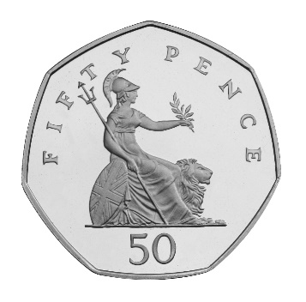
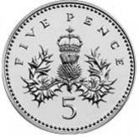
Scarlett buys four packets of nuts.
She pays with £4 in coins.
This is her change.
What is the cost of one packet of nuts?
50
5 +
5
60
The cost is 340p shared by 4 for each packet
= 85p
85p
16,3b,8

Slide 16
Annabel had some money.
She spent £0.85 on a drink.
She spent £2.19 on a sandwich.
She has half of her money left.
How much did Anabel have to start with?
0.85 +
2.19
3.04
is half,
so whole amount is
double 6.08
£
6.08
16,3b,20

