Slide 1
KS2 Paper 3C
2017
By
Mr Maddison

Slide 2
1. Write the missing number to make this division correct.
1000
586 ÷ = 0.586

Slide 3
A group of friends earns £70 by washing cars.
They share the money equally.
They get £14 each.
How many friends are in the group?
1 x 14 = 14
2 x 14 = 28
3 x 14 = 42
4 x 14 = 56
5 x 14 = 70
5
14
70
5

Slide 4
Harrison uses these digit cards.
He makes a 2-digit number and a 1-digit number.
He multiplies them together.
His answer is a multiple of 10.
What could Harrison’s multiplication be?
3
5
8
3
8
5
x

Slide 5
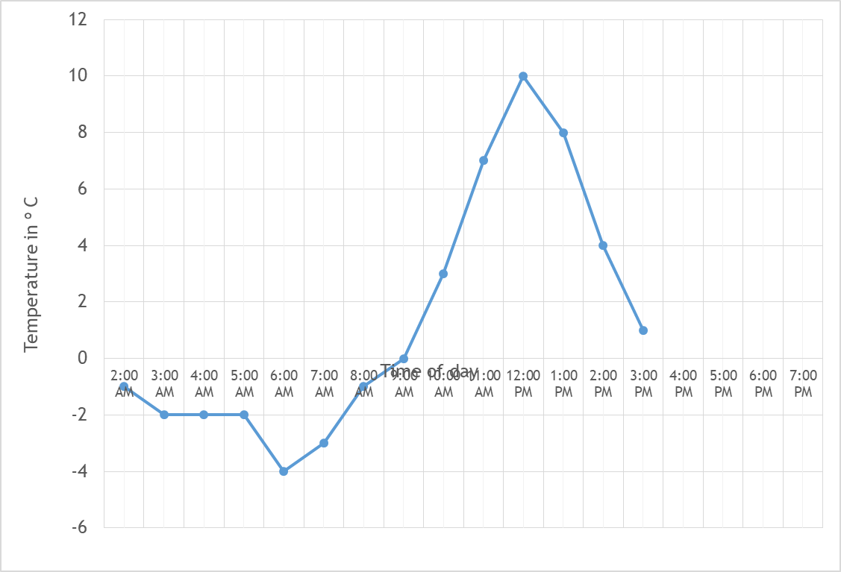
4. This graph shows the temperature in ºC from 2 am to 3 pm on a cold day.
How many degrees warmer was it at 1 pm than 6 am?
12
ºC
8 ºC
from -4 ºC
At 6 pm the temperature was 4 degrees lower than at 3 pm.
What was the temperature at 6 pm
1 ºC
lowered by 4 ºC
-3
ºC

Slide 6
The children at Castle School are collecting money for charity.
Their target is to collect £400
So far they have collected £146.21
How much more do they need to reach their target?
400.00 –
146.21
253.79
£
253.79

Slide 7
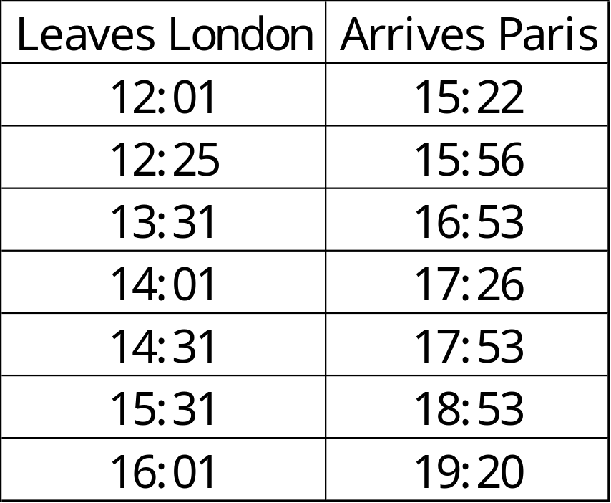
William wants to travel to Paris by train.
He needs to arrive in Paris by 6 pm.
Circle the latest time that William can leave London.
6 pm = 18:00
So 17:53 is the time he should arrive
This leaves London at
14:31

Slide 8

6
5
4
3
2
1
0
-1
-2
-3
-4
-5
-6
Here is a triangle drawn on a coordinate grid.
The triangle is translated 3 right and 6 up.
Draw the triangle in its new position.
-6 -5 -4 -3 -2 -1 0 1 2 3 4 5 6

Slide 9
Write three factors of 36 that are not factors of 12.
9
18
36
Factors of 36 are: 1, 2, 3, 4, 6, 9, 12, 18, 36
Factors of 12 are: 1, 2, 3, 4, 6, 12

Slide 10
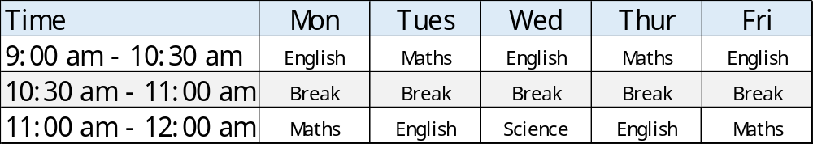
9. Here is the morning timetable for Chen’s class this week.
What is the total number of hours of English on this timetable?
3 x 1 ½
+ 2
6 ½
hours

Slide 11
A bottle contains 620 millilitres of milk.
Jack pours out half a litre.
How much milk is left?
1 l = 1000 ml
½ l = 500 ml
620 –
500
120
120 ml

Slide 12
A bicycle wheel has a diameter of 54 cm.
What is the radius of the bicycle wheel?
Radius is half the diameter
54 ÷ 2 = 27
27
cm

Slide 13
Mia buys 8 bags of white balloons.
Amy buys 4 bags of red balloons.
Mia says,
‘I have four times as many balloons as Amy.’
Explain why Mia is correct.
20 white balloons in a pack
10 red balloons
in a pack
20 x
8
160
10 x
4
40
40 x
4
160

Slide 14
13. Circle the hexagon with exactly four acute angles.
Pentagon
5 obtuse
Pentagon
2 obtuse
2 right angles
1 acute
Pentagon
4 acute
1 reflex
Hexagon
4 acute
2 reflex
Hexagon
6 obtuse

Slide 15
4 pineapples cost the same as 3 mangoes.
One mango costs £1.20
How much does one pineapple cost?
1.20 x
3
3.60
0.9
4
3.60
£
0.90

Slide 16
Look at the letters below.
Circle any letter below which has both vertical and horizontal lines.
A C E L Z
horizontal
vertical

Slide 17
There are 1,900 leaflets in a box.
Kerry and Lola take 370 leaflets each.
Lyla and Harrison share the rest of the leaflets equally.
How many leaflets does Harrison get?
830
370 x
2
740
2400 -
740
1660
2
1660
830

Slide 18
In each box, circle the number that is greater.
1 ½
=1.5
1.6
1 ³/₄
=1.75
1.8
1 ¹⁹/₁₀₀
v
= 1.19
1.2
v
1 ⁴/₅
=1.8
1.09

Slide 19
A square number and a prime number have a total of 22
What are the two numbers?
4
+
7
= 11
square number
prime number
Square: 1, 4, 9, 16, 25
Prime: 2, 3, 5, 7, 11, 13, 17, 19

Slide 20
8 x 11 = 88 = 90 to nearest 10
8 x 12 = 96 = 100 to nearest 10
8 x 13 = 104= 100 to nearest 10
8 x 14 = 112= 110 to nearest 10
Harrison thinks of a whole number.
He multiplies it by 8
He rounds his answer to the nearest 10
The result is 100
Write all the numbers that Harrison could have started with.
12, 13

Slide 21
A square tile measures 30cm by 30cm.
A rectangular tile is 6 cm longer and 5 cm narrower than the square tile.
What is the difference in area between the two tiles?
30cm
30cm
Area of square tile = 30 x 30 = 900 cm²
Area of rectangle = 36 x 25
36 x
25
180
720
900
Difference = 900 – 900
= 0
0
cm²

Slide 22
21. The numbers in this sequence increase by the same amount each time.
Write the missing numbers.
⁵/₆
1
1 ¹/₆
1 ¹/₃
1 ¹/₂
¹/₆ larger
¹/₆ larger?
1 ¹/₆ + ¹/₆ = 1 ²/₆
¹/₆ smaller than 1 is ⁵/₆
¹/₆ larger than 1 ²/₆ is 1 ³/₆

Slide 23
22. In this diagram, the shaded rectangles are all of equal width (w).
28 = 13 + 6 + w
28 = 19 + w
9 = w
w
28 cm
13 cm
w
6 cm
w
Calculate the width (w) of one shaded rectangle.
9
cm

Slide 24
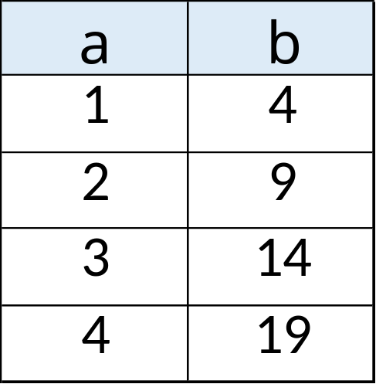
23. Here is a pattern of number pairs.
The numbers increase by
5 each time
Complete the rule for the number pattern.
5
1
b = x a -

Slide 25
24. Cube A and cuboid B have the same volume.
Not to scale
9 cm
A
? cm
B
9 cm
27 cm
Calculate the missing length on cuboid B.
Volume of A = 9 x 9 x 9
= 729
Volume of B = 27 x 9 x ?
= 243 x ?
3
cm
So, 729 = 243 x ?
? = 3
9 x 9 x 9 = 27 x 9 x ?
OR
81 = 27 x ?
3 = ?

