Slide 1
KS2 Paper 3C
2017
By
Mr Maddison

Slide 2
1. Write the missing number to make this division correct.
586 ÷ = 0.586

Slide 3
A group of friends earns £70 by washing cars.
They share the money equally.
They get £14 each.
How many friends are in the group?

Slide 4
Harrison uses these digit cards.
He makes a 2-digit number and a 1-digit number.
He multiplies them together.
His answer is a multiple of 10.
What could Harrison’s multiplication be?
3
5
8
x

Slide 5
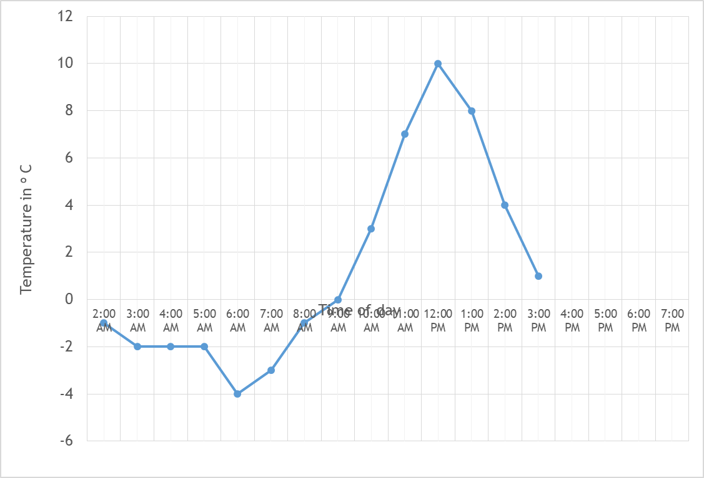
4. This graph shows the temperature in ºC from 2 am to 3 pm on a cold day.
How many degrees warmer was it at 1 pm than 6 am?
ºC
At 6 pm the temperature was 4 degrees lower than at 3 pm.
What was the temperature at 6 pm
ºC

Slide 6
The children at Castle School are collecting money for charity.
Their target is to collect £400
So far they have collected £146.21
How much more do they need to reach their target?
£

Slide 7
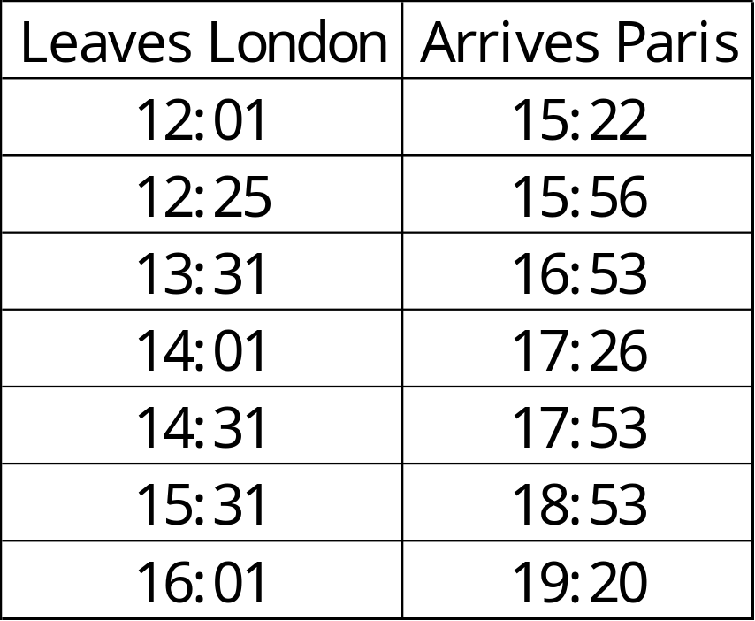
William wants to travel to Paris by train.
He needs to arrive in Paris by 6 pm.
Circle the latest time that William can leave London.

Slide 8

6
5
4
3
2
1
0
-1
-2
-3
-4
-5
-6
Here is a triangle drawn on a coordinate grid.
The triangle is translated 3 right and 6 up.
Draw the triangle in its new position.
-6 -5 -4 -3 -2 -1 0 1 2 3 4 5 6

Slide 9
Write three factors of 36 that are not factors of 12.

Slide 10
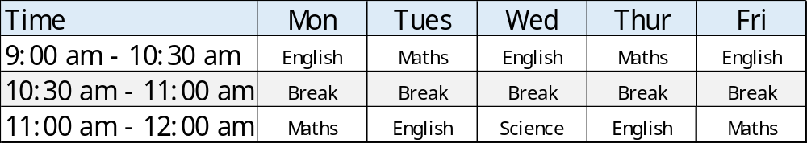
9. Here is the morning timetable for Chen’s class this week.
What is the total number of hours of English on this timetable?
hours

Slide 11
A bottle contains 620 millilitres of milk.
Jack pours out half a litre.
How much milk is left?

Slide 12
A bicycle wheel has a diameter of 54 cm.
What is the radius of the bicycle wheel?
cm

Slide 13
Mia buys 8 bags of white balloons.
Amy buys 4 bags of red balloons.
Mia says,
‘I have four times as many balloons as Amy.’
Explain why Mia is correct.
20 white balloons in a pack
10 red balloons
in a pack

Slide 14
13. Circle the hexagon with exactly four acute angles.

Slide 15
4 pineapples cost the same as 3 mangoes.
One mango costs £1.20
How much does one pineapple cost?
£

Slide 16
Look at the letters below.
Circle any letter below which has both vertical and horizontal lines.
A C E L Z

Slide 17
There are 1,900 leaflets in a box.
Kerry and Lola take 370 leaflets each.
Lyla and Harrison share the rest of the leaflets equally.
How many leaflets does Harrison get?

Slide 18
In each box, circle the number that is greater.
1 ½
1.6
1 ³/₄
1.8
1 ¹⁹/₁₀₀
1.2
1 ⁴/₅
1.09

Slide 19
A square number and a prime number have a total of 11
What are the two numbers?
+
= 11
square number
prime number

Slide 20
Harrison thinks of a whole number.
He multiplies it by 8
He rounds his answer to the nearest 10
The result is 100
Write all the numbers that Harrison could have started with.

Slide 21
A square tile measures 30cm by 30cm.
A rectangular tile is 6 cm longer and 5 cm narrower than the square tile.
What is the difference in area between the two tiles?
30cm
30cm
cm²

Slide 22
21. The numbers in this sequence increase by the same amount each time.
Write the missing numbers.
1
1 ¹/₆
1 ¹/₃

Slide 23
22. In this diagram, the shaded rectangles are all of equal width (w).
w
28 cm
13 cm
w
6 cm
w
Calculate the width (w) of one shaded rectangle.
cm

Slide 24
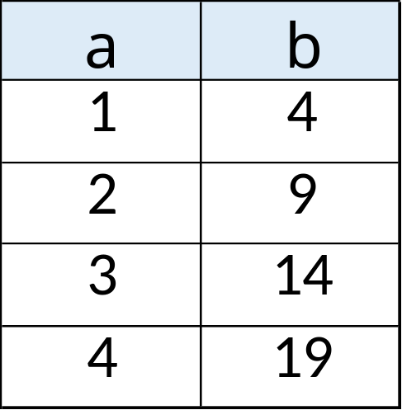
23. Here is a pattern of number pairs.
Complete the rule for the number pattern.
b = x a -

Slide 25
24. Cube A and cuboid B have the same volume.
Not to scale
9 cm
A
? cm
B
9 cm
27 cm
Calculate the missing length on cuboid B.
cm

