Slide 1
KS2 Paper 3B
2017
By
Mr Maddison

Slide 2
1. Write the missing number to make this division correct.
10
61 ÷ = 6.1

Slide 3
A group of friends earns £78 by washing cars.
They share the money equally.
They get £13 each.
How many friends are in the group?
1 x 13 = 13
2 x 13 = 26
3 x 13 = 39
4 x 13 = 52
5 x 13 = 65
6 x 13 = 78
6
13
78
6

Slide 4
Max uses these digit cards.
He makes a 2-digit number and a 1-digit number.
He multiplies them together.
His answer is a multiple of 10.
What could Max’s multiplication be?
3
5
8
3
8
5
x

Slide 5
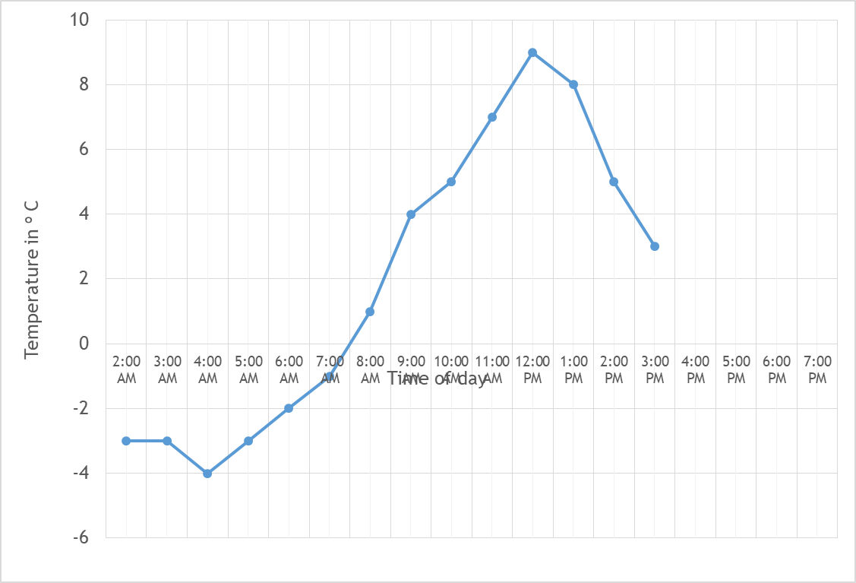
4. This graph shows the temperature in ºC from 2 am to 3 pm on a cold day.
How many degrees warmer was it at 1 pm than 4 am?
12
ºC
8 ºC
from -4 ºC
At 6 pm the temperature was 5 degrees lower than at 3 pm.
What was the temperature at 6 pm
3 ºC
lowered by 5 ºC
-2
ºC

Slide 6
The children at Sholing School are collecting money for charity.
Their target is to collect £220
So far they have collected £69.51
How much more do they need to reach their target?
220.00 –
69.51
150.49
£
150.49

Slide 7
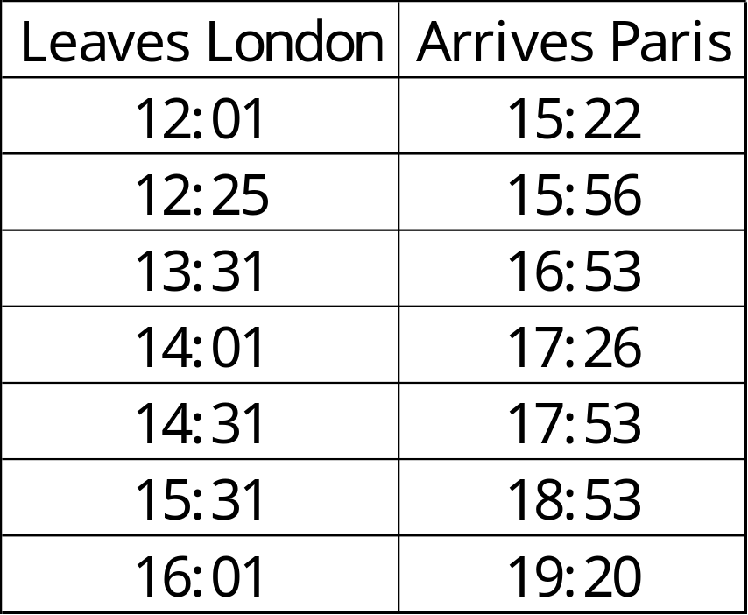
William wants to travel to Paris by train.
He needs to arrive in Paris by 7:30 pm.
Circle the latest time that William can leave London.
7:30 pm = 19:30
So 19:20 is the time he should arrive
This leaves London at
16:01

Slide 8

6
5
4
3
2
1
0
-1
-2
-3
-4
-5
-6
Here is a triangle drawn on a coordinate grid.
The triangle is translated 8 right and 1 down.
Draw the triangle in its new position.
-6 -5 -4 -3 -2 -1 0 1 2 3 4 5 6

Slide 9
Write three factors of 24 that are not factors of 18.
4
8
12
Factors of 24 are: 1, 2, 3, 4, 6, 8, 12, 24
Factors of 18 are: 1, 2, 3, 6, 9, 18

Slide 10
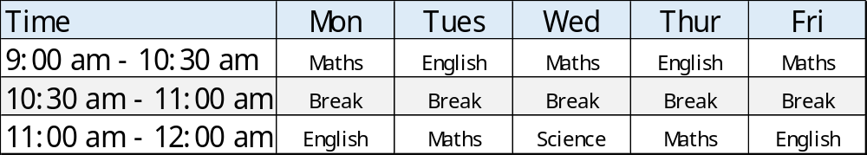
9. Here is the morning timetable for Chen’s class this week.
What is the total number of hours of Maths on this timetable?
3 x 1 ½
+ 2
6 ½
hours

Slide 11
A bottle contains 955 millilitres of milk.
Jack pours out three quarters of a litre.
How much milk is left?
1 l = 1000 ml
¼ l = 250 ml
³/₄ l = 750 ml
955 –
750
205
205 ml

Slide 12
A bicycle wheel has a diameter of 62 cm.
What is the radius of the bicycle wheel?
Radius is half the diameter
62 ÷ 2 = 31
31
cm

Slide 13
Mollie buys 6 bags of white balloons.
Harriett buys 3 bags of red balloons.
Mollie says,
‘I have three times as many balloons as Harriett.’
Explain why Mollie is correct.
18 white balloons in a pack
12 red balloons
in a pack
18 x
6
108
12 x
3
36
36 x
3
108

Slide 14
13. Circle the octagon with exactly two acute angles.
Octagon
2 acute
4 obtuse
1 reflex
Pentagon
2 obtuse
2 right angles
1 acute
Hexagon
2 acute
3 obtuse
1 reflex
Octagon
8 obtuse
Hexagon
6 obtuse

Slide 15
5 pineapples cost the same as 3 mangoes.
One mango costs £1.70
How much does one pineapple cost?
1.70 x
3
5.10
1.02
5
5.10
£
1.02

Slide 16
Look at the letters below.
Circle any letter below which has just one horizontal line.
A C E L Z
horizontal

Slide 17
There are 2,960 leaflets in a box.
Kelsi and Harriett take 720 leaflets each.
Rosie and Mollie share the rest of the leaflets equally.
How many leaflets does Rosie get?
760
720 x
2
1440
2960 -
1440
1520
2
1520
760

Slide 18
In each box, circle the number that is greater.
1 ½
=1.5
1.06
1 ¹/₈
=1.125
1.12
1 ⁷³/₁₀₀
v
=1.73
1.8
1 ¹/₅
v
=1.2
1.3

Slide 19
A square number and a prime number have a total of 22
What are the two numbers?
25
+
13
= 38
square number
prime number
Square: 1, 4, 9, 16, 25
Prime: 2, 3, 5, 7, 11, 13, 17, 19

Slide 20
7 x 12 = 84 = 80 to nearest 10
7 x 13 = 91 = 90 to nearest 10
7 x 14 = 98= 100 to nearest 10
7 x 15 = 105= 110 to nearest 10
Max thinks of a whole number.
He multiplies it by 7
He rounds his answer to the nearest 10
The result is 90
Write all the numbers that Max could have started with.
13

Slide 21
A square tile measures 20cm by 20cm.
A rectangular tile is 5cm longer and 3cm narrower than the square tile.
What is the difference in area between the two tiles?
20cm
20cm
Area of square tile = 20 x 20 = 400 cm²
Area of rectangle = 25 x 17
25 x
17
175
250
425
Difference = 425 – 400
= 25
25
cm²

Slide 22
21. The numbers in this sequence increase by the same amount each time.
Write the missing numbers.
¹/₆
1
1 ⁵/₆
2 ²/₃
3 ¹/₂
⁵/₆ larger
⁵/₆ larger?
1 ⁵/₆ + ⁵/₆ = 1 ¹⁰/₆ = 2 ⁴/₆
⁵/₆ smaller than 1 is ¹/₆
⁵/₆ larger than 2 ⁴/₆ is 2 ⁹/₆
= 3 ³/₆

Slide 23
22. In this diagram, the shaded rectangles are all of equal width (w).
29 = 14 + 7 + w
29 = 21 + w
8 = w
w
29 cm
14 cm
w
7 cm
w
Calculate the width (w) of one shaded rectangle.
8
cm

Slide 24
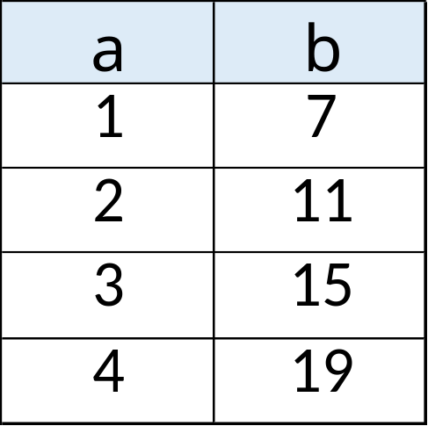
23. Here is a pattern of number pairs.
The numbers increase by
4 each time
Complete the rule for the number pattern.
4
3
b = x a +

Slide 25
24. Cube A and cuboid B have the same volume.
Not to scale
8 cm
A
? cm
B
8 cm
16 cm
Calculate the missing length on cuboid B.
Volume of A = 8 x 8 x 8
= 512
Volume of B = 16 x 8 x ?
= 128 x ?
4
cm
So, 512 = 128 x ?
? = 4
8 x 8 x 8 = 8 x 16 x ?
OR
64 = 16 x ?
4 = ?

