Slide 1
KS2 Paper 3A
2017
By
Mr Maddison

Slide 2
1. Write the missing number to make this division correct.
100
83 ÷ = 0.83

Slide 3
A group of friends earns £72 by washing cars.
They share the money equally.
They get £18 each.
How many friends are in the group?
1 x 18 = 18
2 x 18 = 36
3 x 18 = 54
4 x 18 = 72
4
18
72
4

Slide 4
Thomas uses these digit cards.
He makes a 2-digit number and a 1-digit number.
He multiplies them together.
His answer is a multiple of 10.
What could Thomas’s multiplication be?
5
7
8
7
8
5
x

Slide 5
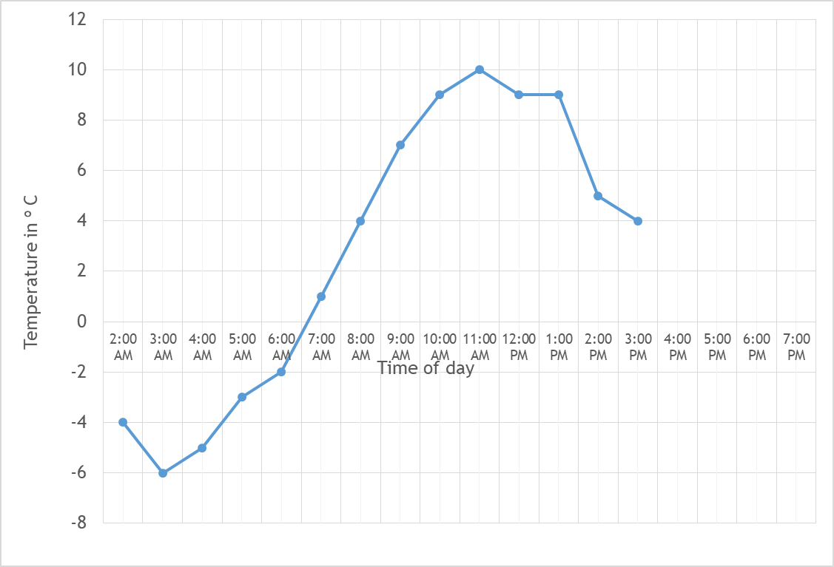
4. This graph shows the temperature in ºC from 2 am to 3 pm on a cold day.
How many degrees warmer was it at 2 pm than 2 am?
9
ºC
5 ºC
from -4 ºC
At 6 pm the temperature was 5 degrees lower than at 3 pm.
What was the temperature at 6 pm
4 ºC
lowered by 5 ºC
-1
ºC

Slide 6
The children at Northern School are collecting money for charity.
Their target is to collect £500
So far they have collected £238.12
How much more do they need to reach their target?
500.00 –
238.12
261.88
£
261.88

Slide 7
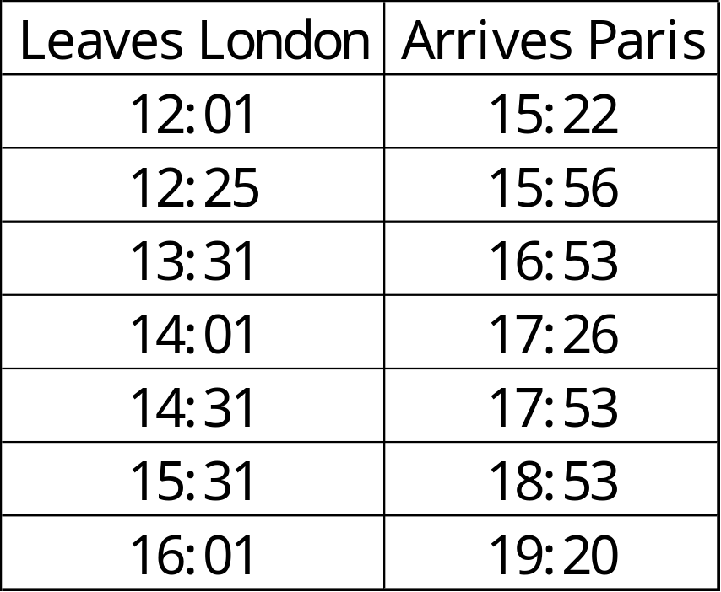
William wants to travel to Paris by train.
He needs to arrive in Paris by 4 pm.
Circle the latest time that William can leave London.
4 pm = 16:00
So 15:56 is the time he should arrive
This leaves London at
12:25

Slide 8

6
5
4
3
2
1
0
-1
-2
-3
-4
-5
-6
Here is a triangle drawn on a coordinate grid.
The triangle is translated 1 right and 4 up.
Draw the triangle in its new position.
-6 -5 -4 -3 -2 -1 0 1 2 3 4 5 6

Slide 9
Write two factors of 18 that are not factors of 12.
9
18
Factors of 18 are: 1, 2, 3, 6, 9, 18
Factors of 12 are: 1, 2, 3, 4, 6, 12

Slide 10
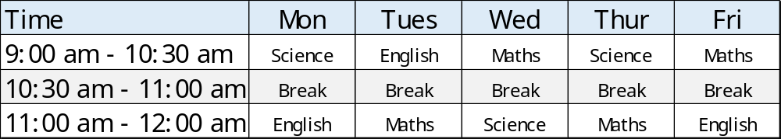
9. Here is the morning timetable for Chen’s class this week.
What is the total number of hours of Science on this timetable?
2 x 1 ½
+ 1
4
hours

Slide 11
A bottle contains 568 millilitres of milk.
Jack pours out quarter of a litre.
How much milk is left?
1 l = 1000 ml
¼ l = 250 ml
568 –
250
318
318 ml

Slide 12
A bicycle wheel has a diameter of 48 cm.
What is the radius of the bicycle wheel?
Radius is half the diameter
48 ÷ 2 = 24
24
cm

Slide 13
Georgina buys 9 bags of white balloons.
Ryan buys 3 bags of red balloons.
Georgina says,
‘I have six times as many balloons as Ryan.’
Explain why Georgina is correct.
36 white balloons in a pack
18 red balloons
in a pack
36 x
9
324
18 x
3
54
54 x
6
324

Slide 14
13. Circle the octagon with more than five obtuse angles.
Octagon
2 acute
4 obtuse
1 reflex
Pentagon
2 obtuse
2 right angles
1 acute
Hexagon
2 acute
3 obtuse
1 reflex
Octagon
8 obtuse
Hexagon
6 obtuse

Slide 15
5 pineapples cost the same as 2 mangoes.
One mango costs £1.25
How much does one pineapple cost?
1.25 x
2
2.50
0.5
5
2.50
£
0.50

Slide 16
Look at the letters below.
Circle any letter below which has no vertical or horizontal lines.
A C E L Z

Slide 17
There are 3,600 leaflets in a box.
Ellie and Esme take 950 leaflets each.
Thomas and Ryan share the rest of the leaflets equally.
How many leaflets does Ryan get?
850
950 x
2
1900
3600 -
1900
1700
2
1700
850

Slide 18
In each box, circle the number that is greater.
1 ½
=1.5
1.07
1 ³/₄
=1.75
1.76
1 ³/₁₀₀
v
=1.03
1.2
1 ²/₅
v
=1.4
1.5

Slide 19
A square number and a prime number have a total of 21
What are the two numbers?
16
+
5
= 21
square number
prime number
Square: 1, 4, 9, 16, 25
Prime: 2, 3, 5, 7, 11, 13, 17, 19

Slide 20
6 x 12 = 72 = 70 to nearest 10
6 x 13 = 78 = 80 to nearest 10
6 x 14 = 84= 80 to nearest 10
6 x 15 = 90= 90 to nearest 10
Thomas thinks of a whole number.
He multiplies it by 6
He rounds his answer to the nearest 10
The result is 80
Write all the numbers that Thomas could have started with.
13, 14

Slide 21
A square tile measures 30cm by 30cm.
A rectangular tile is 4cm longer and 3cm narrower than the square tile.
What is the difference in area between the two tiles?
30cm
30cm
Area of square tile = 30 x 30 = 900 cm²
Area of rectangle = 34 x 27
34 x
27
238
680
918
Difference = 918 – 900
= 18
18
cm²

Slide 22
21. The numbers in this sequence increase by the same amount each time.
Write the missing numbers.
⁵/₈
1
1 ³/₈
1 ³/₄
2 ¹/₈
³/₈ larger
³/₈ larger?
1 ⁶/₈ = 1 ¾
³/₈ smaller than 1 is ⁵/₈
³/₈ larger than 1 ⁶/₈ is 1 ⁹/₈

Slide 23
22. In this diagram, the shaded rectangles are all of equal width (w).
36 = 17 + 11 + w
36 = 28 + w
8 = w
w
36 cm
17 cm
w
11 cm
w
Calculate the width (w) of one shaded rectangle.
8
cm

Slide 24
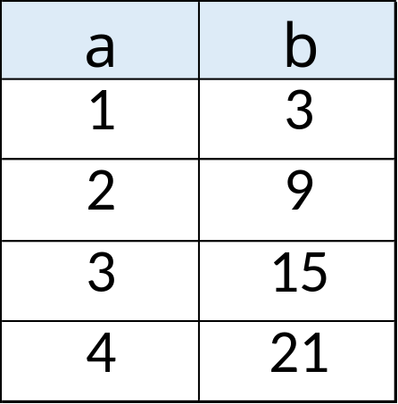
23. Here is a pattern of number pairs.
The numbers increase by
6 each time
Complete the rule for the number pattern.
6
3
b = x a -

Slide 25
24. Cube A and cuboid B have the same volume.
Not to scale
4 cm
A
? cm
B
4 cm
8
Calculate the missing length on cuboid B.
Volume of A = 4 x 4 x 4
= 64
Volume of B = 8 x 4 x ?
= 32 x ?
2
cm
So, 64 = 32 x ?
? = 2

