Slide 1
KS2 Paper 3A
2017
By
Mr Maddison

Slide 2
1. Write the missing number to make this division correct.
83 ÷ = 0.83

Slide 3
A group of friends earns £72 by washing cars.
They share the money equally.
They get £18 each.
How many friends are in the group?

Slide 4
Thomas uses these digit cards.
He makes a 2-digit number and a 1-digit number.
He multiplies them together.
His answer is a multiple of 10.
What could Thomas’s multiplication be?
5
7
8
x

Slide 5
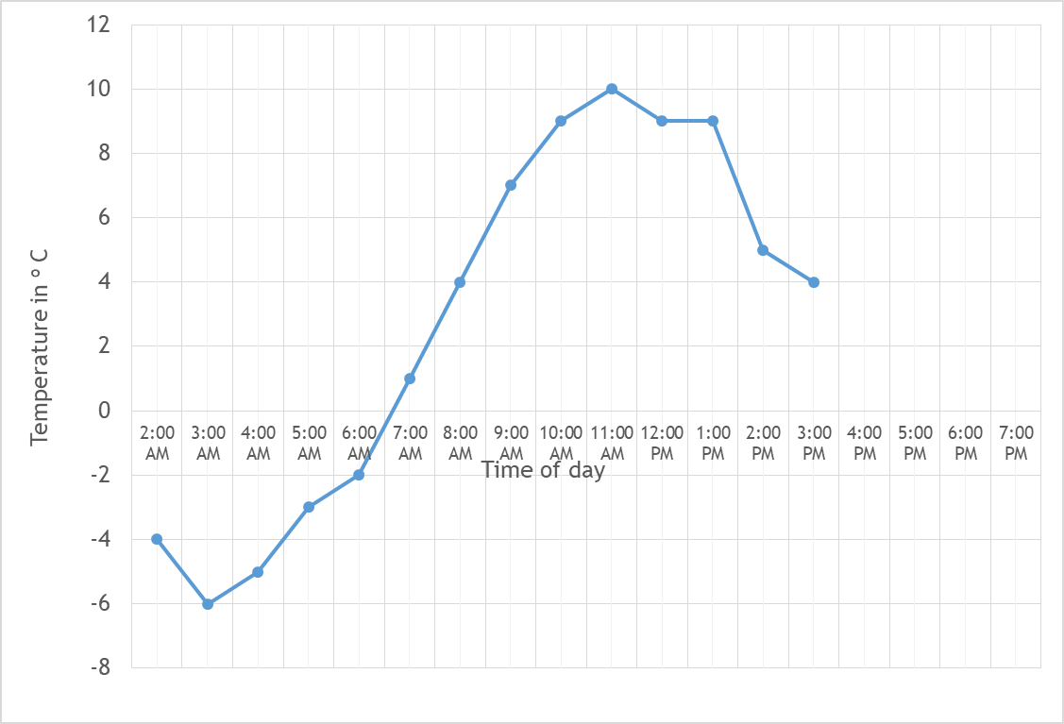
4. This graph shows the temperature in ºC from 2 am to 3 pm on a cold day.
How many degrees warmer was it at 2 pm than 2 am?
ºC
At 6 pm the temperature was 5 degrees lower than at 3 pm.
What was the temperature at 6 pm
ºC

Slide 6
The children at Northern School are collecting money for charity.
Their target is to collect £500
So far they have collected £238.12
How much more do they need to reach their target?
£

Slide 7
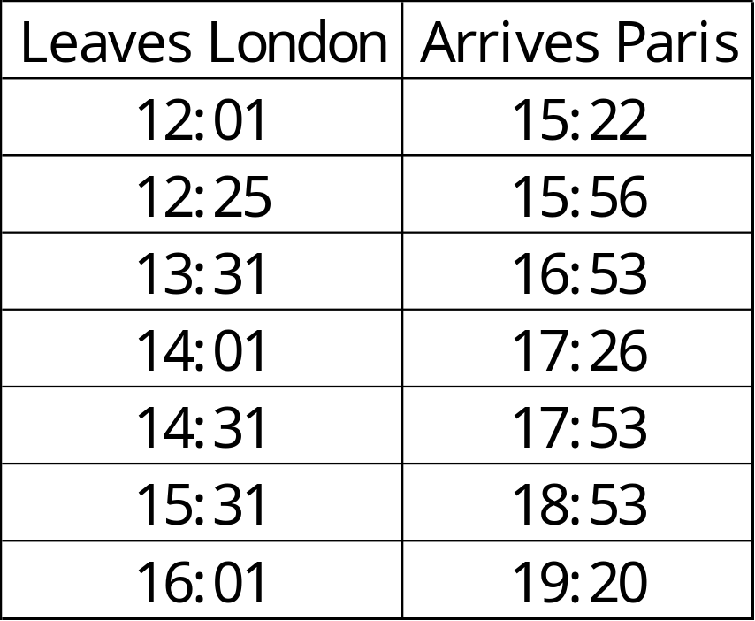
William wants to travel to Paris by train.
He needs to arrive in Paris by 4 pm.
Circle the latest time that William can leave London.

Slide 8

6
5
4
3
2
1
0
-1
-2
-3
-4
-5
-6
Here is a triangle drawn on a coordinate grid.
The triangle is translated 1 right and 4 up.
Draw the triangle in its new position.
-6 -5 -4 -3 -2 -1 0 1 2 3 4 5 6

Slide 9
Write two factors of 18 that are not factors of 12.
9
18

Slide 10
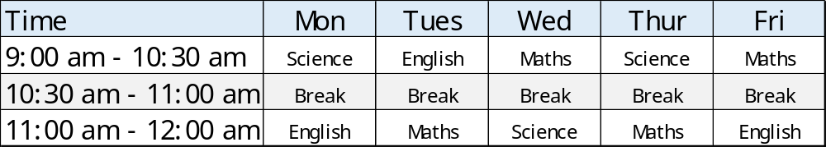
9. Here is the morning timetable for Chen’s class this week.
What is the total number of hours of Science on this timetable?
hours

Slide 11
A bottle contains 568 millilitres of milk.
Jack pours out quarter of a litre.
How much milk is left?

Slide 12
A bicycle wheel has a diameter of 48 cm.
What is the radius of the bicycle wheel?
cm

Slide 13
Georgina buys 9 bags of white balloons.
Ryan buys 3 bags of red balloons.
Georgina says,
‘I have six times as many balloons as Ryan.’
Explain why Georgina is correct.
36 white balloons in a pack
18 red balloons
in a pack

Slide 14
13. Circle the octagon with exactly more than five obtuse angles.

Slide 15
5 pineapples cost the same as 2 mangoes.
One mango costs £1.25
How much does one pineapple cost?
£

Slide 16
Look at the letters below.
Circle any letter below which has no vertical or horizontal lines.
A C E L Z

Slide 17
There are 3,600 leaflets in a box.
Ellie and Esme take 950 leaflets each.
Thomas and Ryan share the rest of the leaflets equally.
How many leaflets does Ryan get?

Slide 18
In each box, circle the number that is greater.
1 ½
1.07
1 ³/₄
1.76
1 ³/₁₀₀
1.2
1 ²/₅
1.5

Slide 19
A square number and a prime number have a total of 21
What are the two numbers?
+
= 21
square number
prime number

Slide 20
Thomas thinks of a whole number.
He multiplies it by 6
He rounds his answer to the nearest 10
The result is 80
Write all the numbers that Thomas could have started with.

Slide 21
A square tile measures 30cm by 30cm.
A rectangular tile is 4cm longer and 3cm narrower than the square tile.
What is the difference in area between the two tiles?
30cm
30cm
cm²

Slide 22
21. The numbers in this sequence increase by the same amount each time.
Write the missing numbers.
1
1 ³/₈
1 ³/₄

Slide 23
22. In this diagram, the shaded rectangles are all of equal width (w).
w
36 cm
17 cm
w
11 cm
w
Calculate the width (w) of one shaded rectangle.
cm

Slide 24
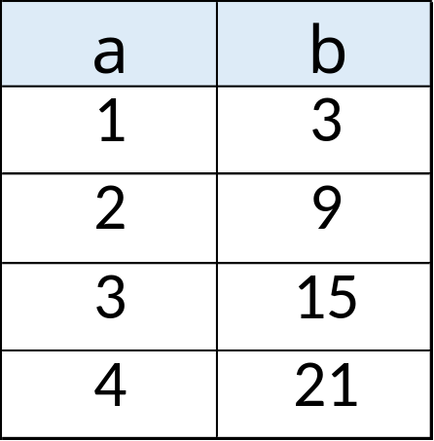
23. Here is a pattern of number pairs.
Complete the rule for the number pattern.
b = x a -

Slide 25
24. Cube A and cuboid B have the same volume.
Not to scale
4 cm
A
? cm
B
4 cm
8
Calculate the missing length on cuboid B.
cm

