Slide 1
KS2 Paper 2C
2017
By
Mr Maddison

Slide 2
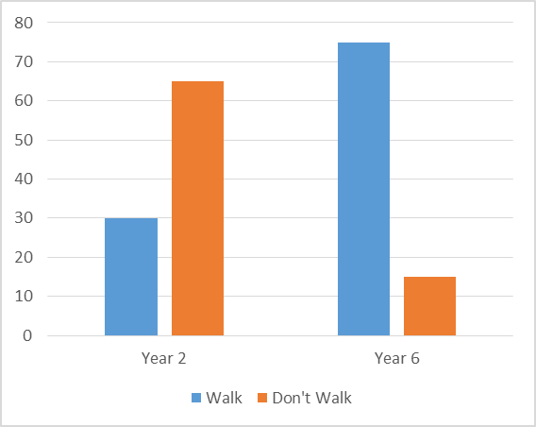
1. William asks the children in Year 2 and Year 6 if they walk to school. The graph shows the results.
Number of children
Altogether, how many children don’t walk to school?
How many more Year 6 children than Year 2 children walk to school?

Slide 3
2. Circle the number that is 10 times smaller than four hundred and eight.
40.8 4,080 40,800 4.08 408

Slide 4
3. Write the missing numbers to make this multiplication grid correct.
x
5 | 20 | 30
 | 36 | 54

Slide 5
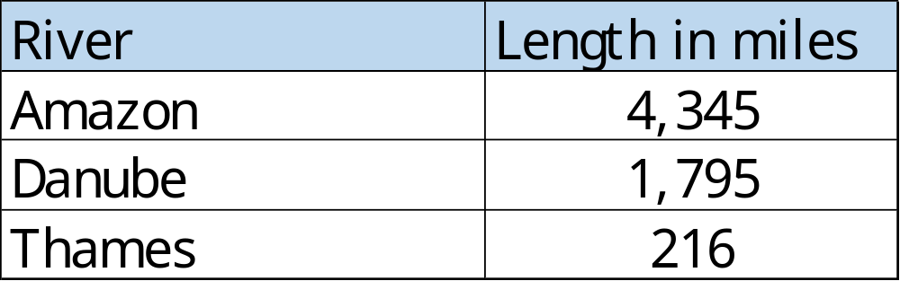
4. This table shows the lengths of three rivers.
Amy says the Amazon is more than twenty times longer than the Thames. Is she correct? You must show a calculation to explain your answer.

Slide 6
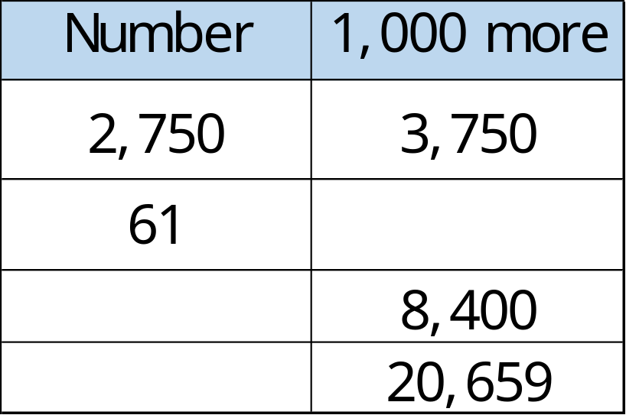
Complete this table with the missing numbers.
One row has been done for you.

Slide 7
6. Write these numbers in order of size, starting with the largest and decreasing.
0.083 0.94 0.077 0.86
smallest

Slide 8
7. Write the missing numbers.
8 minutes = seconds
9 weeks = days
300 years = centuries

Slide 9
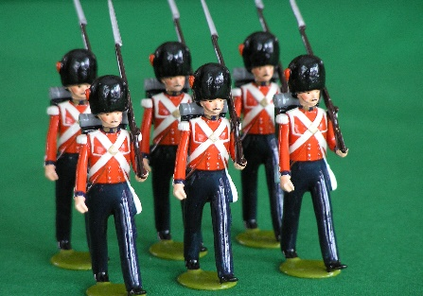
At the start of April, there were 695 toy soldiers in the shop.
During April,
2,765 more toy soldiers were delivered
1,921 toy soldiers were sold
How many toy soldiers were left in the shop at the end of April?

Slide 10
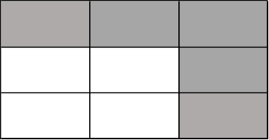
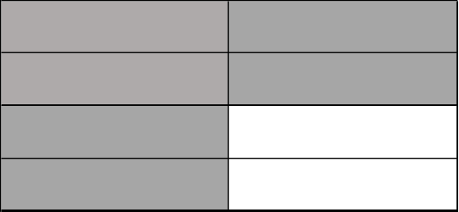
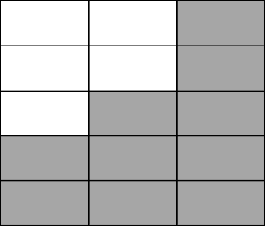
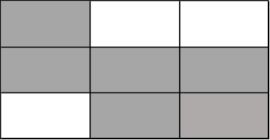
9. Tick two shapes that have ²/₃ shaded.

Slide 11
10. Round 173,989
to nearest 10
to nearest 100
to nearest 1000

Slide 12
11. Here is a rule for the time it takes to cook a lamb joint.
Cooking time = 25 minutes plus an extra
25 minutes for each 500g
How many minutes will it take to cook a 5kg lamb joint?
What is the mass of lamb that takes 125 minutes to cook?
minutes
kg

Slide 13


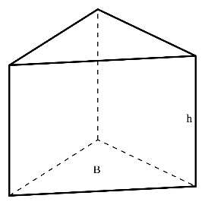

Here are diagrams of some 3-D shapes.
Tick each shape that obeys the rule: faces + vertices - 2 = edges
Cube
Square-based pyramid
Triangular prism
Triangular-based pyramid

Slide 14
13. Thomas and Max buy some stickers.
Pack of 25 stickers
£23.91
25 stickers
99p each
Thomas buys a pack of 25 stickers for £23.91
Max buys 25 single stickers for 99p each.
How much more does Max pay than Thomas?
£

Slide 15
Lola planted some seeds.
For every 5 seeds Lola planted, only 3 seeds grew.
Altogether, 21 seeds grew.
How many seeds did Lola plant?

Slide 16
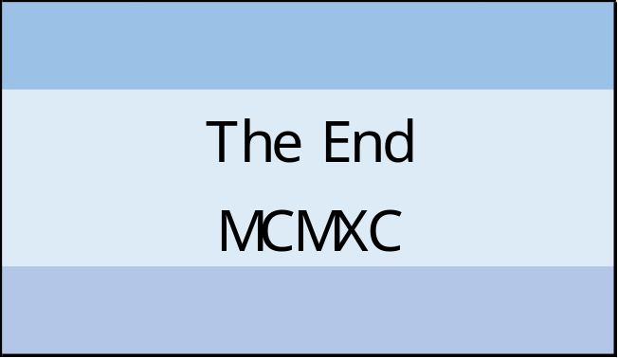
15. At the end of a film, the year is given in Roman numerals.
Write the year MCMXC in figures.

Slide 17

16. Kelsi completes one-and-a-half somersaults in a dive.
Start
o
How many degrees does Kelsi turn through in her dive?

Slide 18

6
5
4
3
2
1
0
-1
-2
-3
-4
-5
-6
The vertices of a quadrilateral have these coordinates.
(4,4) (4,-1) (-3,-4) (-3,4)
One side of the quadrilateral has been drawn on the grid.
Complete the quadrilateral.
Use a ruler.
-6 -5 -4 -3 -2 -1 0 1 2 3 4 5 6

Slide 19

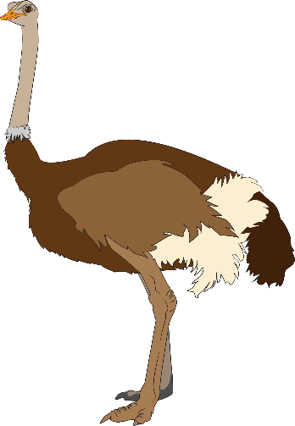
A cat sleeps for 12 hours each day.
50% of its life is spent asleep.
Write the missing percentage.
An ostrich sleeps for 6 hours each day.
of its life is spent asleep.
%

Slide 20
Mia posts five large letters.
The postage costs the same for each letter.
She pays with a £20 note.
Her change is £12.30
What is the cost of posting one letter?
£

Slide 21
Amy says,
0.75 is smaller than ¹⁶/₂₀
Explain why he is correct.

Slide 22

21. On a map, 1cm represents 20km.
0 20 40 60 80 100
kilometres
The distance between two cities is 580 km.
On the map, what is the distance between the two cities?
cm

Slide 23

22. Here are two similar right-angled triangles.
b
a
Write the ratio of side a to side b.
a : b
:

Slide 24
23. In this circle, ½ and ¹/₃ are shaded.
What fraction of the whole circle is not shaded?

