Slide 1
KS2 Paper 2A
2017
By
Mr Maddison

Slide 2
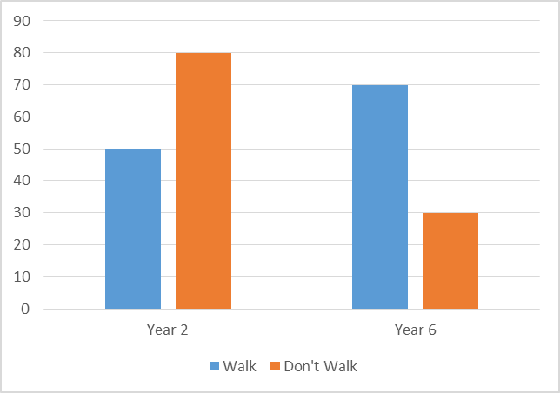
1. William asks the children in Year 2 and Year 6 if they walk to school. The graph shows the results.
Number of children
Altogether, how many children walk to school?
How many more Year 6 children than Year 2 children walk to school?
120
50 + 70
20
70 - 50

Slide 3
2. Circle the number that is 100 times smaller than five hundred and three.
503 ÷ 100
0.53 5.03 5,030 5300 50.3

Slide 4
3. Write the missing numbers to make this multiplication grid correct.
x | 7
 | 35 | 60
8 |  | 96
12
5
56

Slide 5
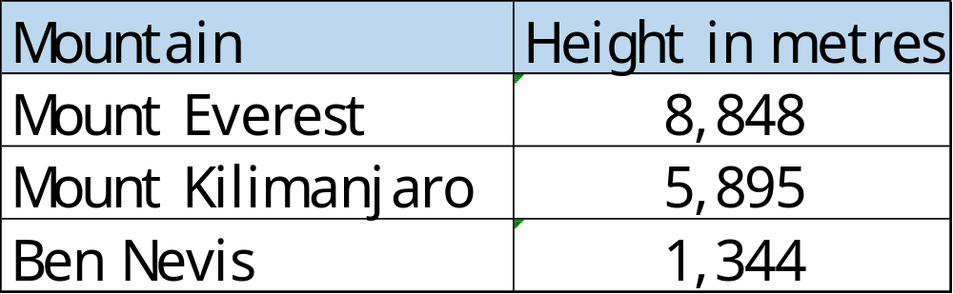
4. This table shows the heights of three mountains.
Steven says Mount Everest is more than six times higher than Ben Nevis. Is he correct? You must show a calculation to explain your answer.
1344 x
6
8064
Yes

Slide 6
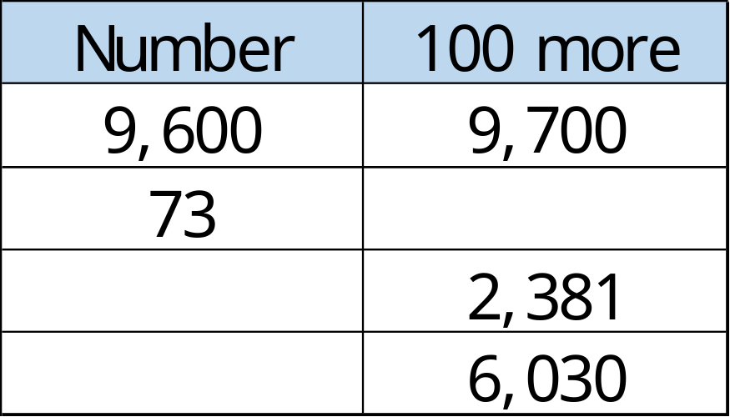
Complete this table with the missing numbers.
One row has been done for you.
173
2,281
5,930

Slide 7
6. Write these numbers in order of size, starting with the smallest.
1.4 0.51 1.326 0.487
0.487
0.51
1.326
1.4
smallest

Slide 8
7. Write the missing numbers.
4
48 months = years
96 hours = days
49 days = weeks
4
7

Slide 9
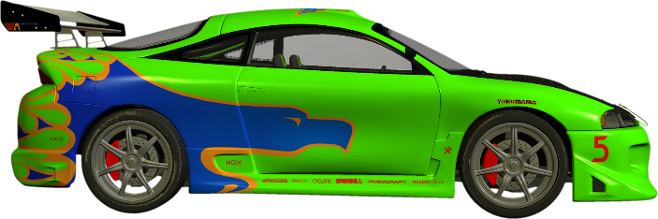
At the start of November, there were 2,384 toy cars in the shop.
During November,
11,609 more toy cars were delivered
8,741 toy cars were sold
How many toy cars were left in the shop at the end of November?
5,252
2384 +
11609
13993
13993-
8741
5252

Slide 10
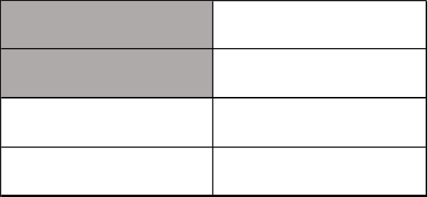
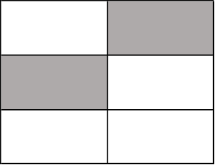
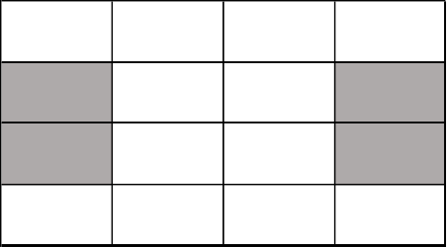
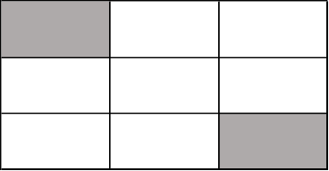
9. Tick two shapes that have ¼ shaded.
²/₈
²/₆
✓
=¹/₄
=¹/₃
⁴/₁₆
²/₉
=¹/₄
✓

Slide 11
10. Round 16,352
16,350
to nearest 10
to nearest 100
to nearest 1000
16,400
16,000

Slide 12
11. Here is a rule for the time it takes to cook a joint of beef.
Cooking time = 30 minutes plus an extra
30 minutes for each 500g
How many minutes will it take to cook a 2 kg beef joint?
What is the mass of beef that takes 90 minutes to cook?
150
minutes
2 kg = 4 x 500g
4 x 30 = 120
120 + 30 = 150
1
kg
90 – 30 = 60
60 ÷ 30 = 2
2 x 500g = 1000g

Slide 13


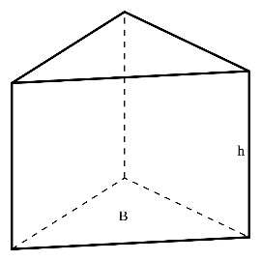

Here are diagrams of some 3-D shapes.
Tick each shape that has three more edges than vertices.
Vertices Edges
8 12
5 8
6 9
4 6
Cube
Square-based pyramid
Triangular prism
Triangular-based pyramid
✓
✓

Slide 14
13. Esme and Ellie buy some stickers.
Pack of 15 stickers
£12.60
15 stickers
97p each
Esme buys a pack of 15 stickers for £12.60
Ellie buys 15 single stickers for 97p each.
How much more does Ellie pay than Esme?
15 x 97p =
£15 – 45p =
£14.55
£14.55 –
£12.60
£ 1.95
1.95
£

Slide 15
Kerry planted some seeds.
For every 4 seeds Kerry planted, only 3 seeds grew.
Altogether, 15 seeds grew.
How many seeds did Kerry plant?
15 ÷ 3 = 5
5 x 4 = 20
20

Slide 16
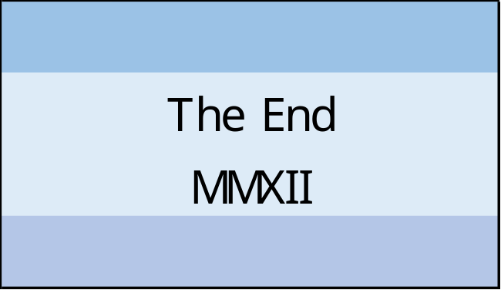
15. At the end of a film, the year is given in Roman numerals.
Write the year MMXII in figures.
M = 1000
X = 10
I = 1
So MM = 2000
XII =12
2012

Slide 17
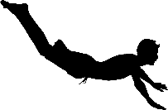
16. Lyla completes a half somersault in a dive.
360 is one complete turn
180 is half a turn
Start
How many degrees does Lyla turn through in her dive?
180
o

Slide 18

6
5
4
3
2
1
0
-1
-2
-3
-4
-5
-6
The vertices of a quadrilateral have these coordinates.
(2,2) (4,-2) (-2,-2) (-4,2)
One side of the quadrilateral has been drawn on the grid.
Complete the quadrilateral.
Use a ruler.
-6 -5 -4 -3 -2 -1 0 1 2 3 4 5 6

Slide 19

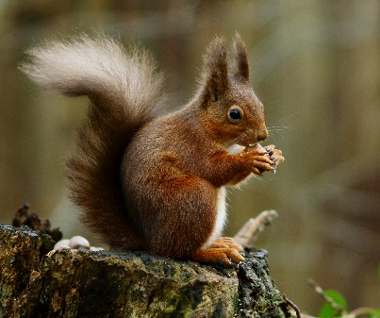
A cat sleeps for 12 hours each day.
½ of its life is spent asleep.
Write the missing fraction.
A squirrel sleeps for 15 hours each day.
of its life is spent asleep.
⁵/₈
¹⁵/₂₄
= ⁵/₈

Slide 20
Harriett posts three large letters.
The postage costs the same for each letter.
She pays with a £20 note.
Her change is £14.84
What is the cost of posting one letter?
1.72
£20.00 –
£14.84
£ 5.16
3
5.16
1.72
£

Slide 21
Harrison says,
0.7 is smaller than ³/₄
Explain why he is correct.
¹/₄ =
0.25
So ¾ = 0.75
0.7 < 0.75

Slide 22

21. On a map, 1cm represents 20km.
0 20 40 60 80 100
350 ÷ 20 =
35 ÷ 2
kilometres
The distance between two cities is 350 km.
On the map, what is the distance between the two cities?
17.5
2
35.0
17.5
cm

Slide 23

22. Here are two similar right-angled triangles.
b
a
Write the ratio of side a to side b.
a : b
:
Sloping sides have the same ratio as the horizontal or vertical sides.
1:3
2:6
1:3

Slide 24
23. In this circle, ½ and ¹/₆ are shaded.
½ + ¹/₆ =
³/₆ + ¹/₆ =
⁴/₆ =
²/₃
So
¹/₃ is not shaded
What fraction of the whole circle is not shaded?

