Slide 1
KS2 Paper 2B
2017
By
Mr Maddison

Slide 2
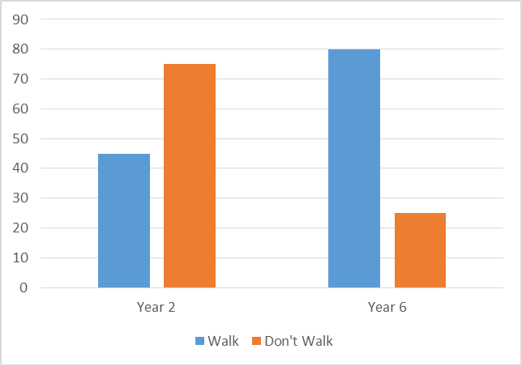
1. William asks the children in Year 2 and Year 6 if they walk to school. The graph shows the results.
Number of children
Altogether, how many children don’t walk to school?
How many more Year 6 children than Year 2 children walk to school?

Slide 3
2. Circle the number that is 100 times greater than two hundred and six.
2,600 20.6 20,600 2,060 206,000

Slide 4
3. Write the missing numbers to make this multiplication grid correct.
x
6 | 48 | 66
9 |  | 99

Slide 5
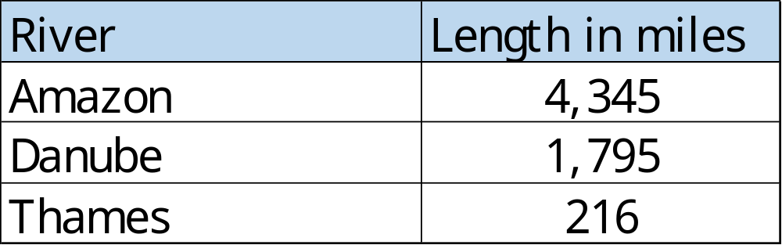
4. This table shows the lengths of three rivers.
How much longer is the Amazon than the combined lengths of the other two rivers?
m

Slide 6
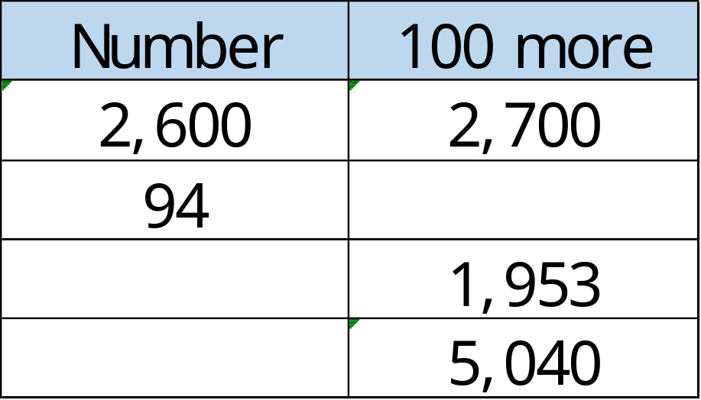
Complete this table with the missing numbers.
One row has been done for you.

Slide 7
6. Write these numbers in order of size, starting with the largest and decreasing.
0.153 0.07 0.068 0.208
smallest

Slide 8
7. Write the missing numbers.
3 minutes = seconds
8 weeks= days
60 years = decades

Slide 9
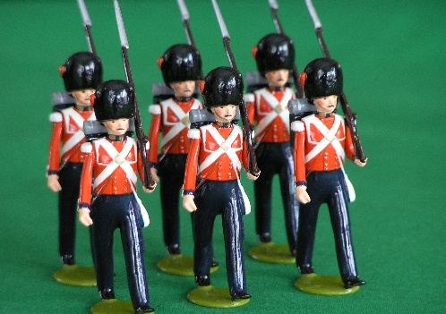
At the start of May, there were 3,405 toy soldiers in the shop.
During May,
4,200 more toy soldiers were delivered
6,985 toy soldiers were sold
How many toy soldiers were left in the shop at the end of May?

Slide 10
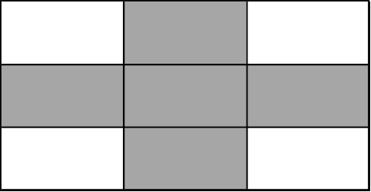
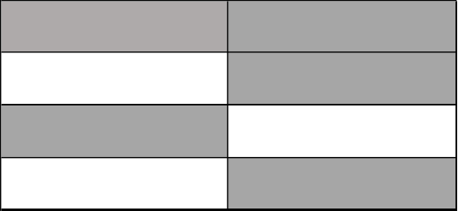
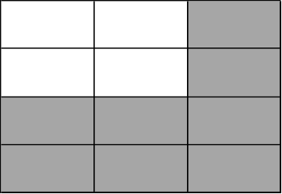
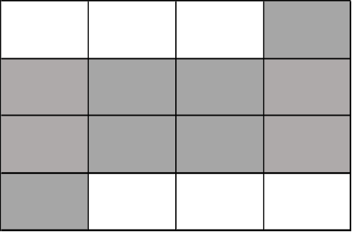
9. Tick two shapes that have ¾ shaded.

Slide 11
10. Round 20,805
to nearest 10
to nearest 100
to nearest 1000

Slide 12
11. Here is a rule for the time it takes to cook a pork joint.
Cooking time = 2 hours plus an extra
20 minutes for each kilogram
How long will it take to cook a 4 kg pork joint?
What is the mass of pork that takes 160 minutes to cook?
hours
minutes
kg

Slide 13


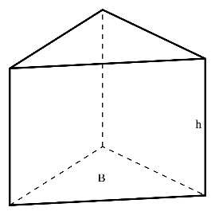

Here are diagrams of some 3-D shapes.
Tick each shape that has twice as many edges as faces.
Cube
Square-based pyramid
Triangular prism
Triangular-based pyramid

Slide 14
13. Ally and Jack buy some stickers.
Pack of 8 stickers
£6.95
8 stickers
98p each
Ally buys a pack of 8 stickers for £6.95
Jack buys 8 single stickers for 98p each.
How much more does Jack pay than Ally?
£

Slide 15
Rosie planted some seeds.
For every 4 seeds Rosie planted, only 3 seeds grew.
Altogether, 18 seeds grew.
How many seeds did Rosie plant?

Slide 16
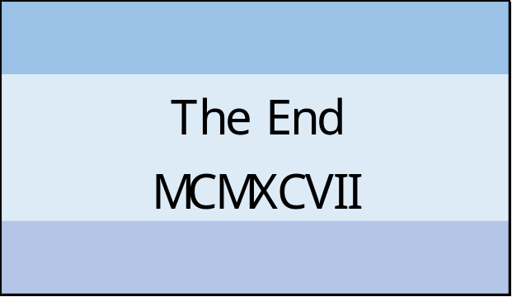
15. At the end of a film, the year is given in Roman numerals.
Write the year MCMXCVII in figures.

Slide 17

16. Layla completes two-and-a-half somersaults in a dive.
Start
How many degrees does Layla turn through in her dive?
o

Slide 18

6
5
4
3
2
1
0
-1
-2
-3
-4
-5
-6
The vertices of a quadrilateral have these coordinates.
(2,3) (3,-1) (-2,3) (-5,-1)
One side of the quadrilateral has been drawn on the grid.
Complete the quadrilateral.
Use a ruler.
-6 -5 -4 -3 -2 -1 0 1 2 3 4 5 6

Slide 19

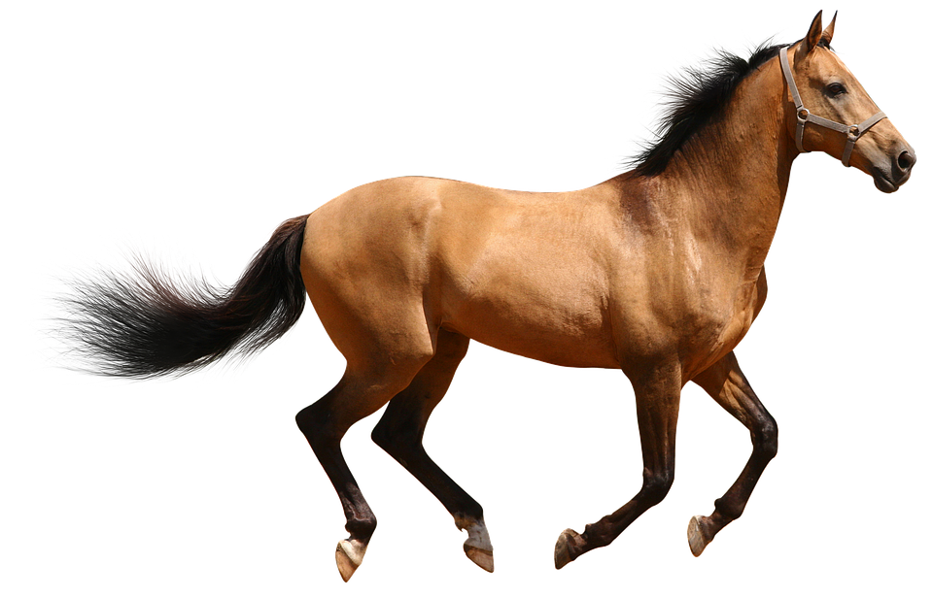
A cat sleeps for 12 hours each day.
½ of its life is spent asleep.
Write the missing fraction.
A horse sleeps for 3 hours each day.
of its life is spent asleep.

Slide 20
Mollie posts four large letters.
The postage costs the same for each letter.
She pays with a £20 note.
Her change is £13.48
What is the cost of posting one letter?
£

Slide 21
Georgina says,
0.15 is smaller than ¹/₅
Explain why he is correct.

Slide 22

21. On a map, 1cm represents 20km.
0 20 40 60 80 100
kilometres
The distance between two cities is 450 km.
On the map, what is the distance between the two cities?
cm

Slide 23

22. Here are two similar right-angled triangles.
b
a
Write the ratio of side a to side b.
a : b
:

Slide 24
23. In this circle, ¼ and ²/₆ are shaded.
What fraction of the whole circle is not shaded?

